Slide 1


Mini Project Presentation
SOUND DETECTION SYSTEM
Presented by:
Sohel Salim Khatik | Roll no. 26203002
&
Pranav Rajendra Kawar | Roll no. 26203011
Branch: E&TC

Slide 2
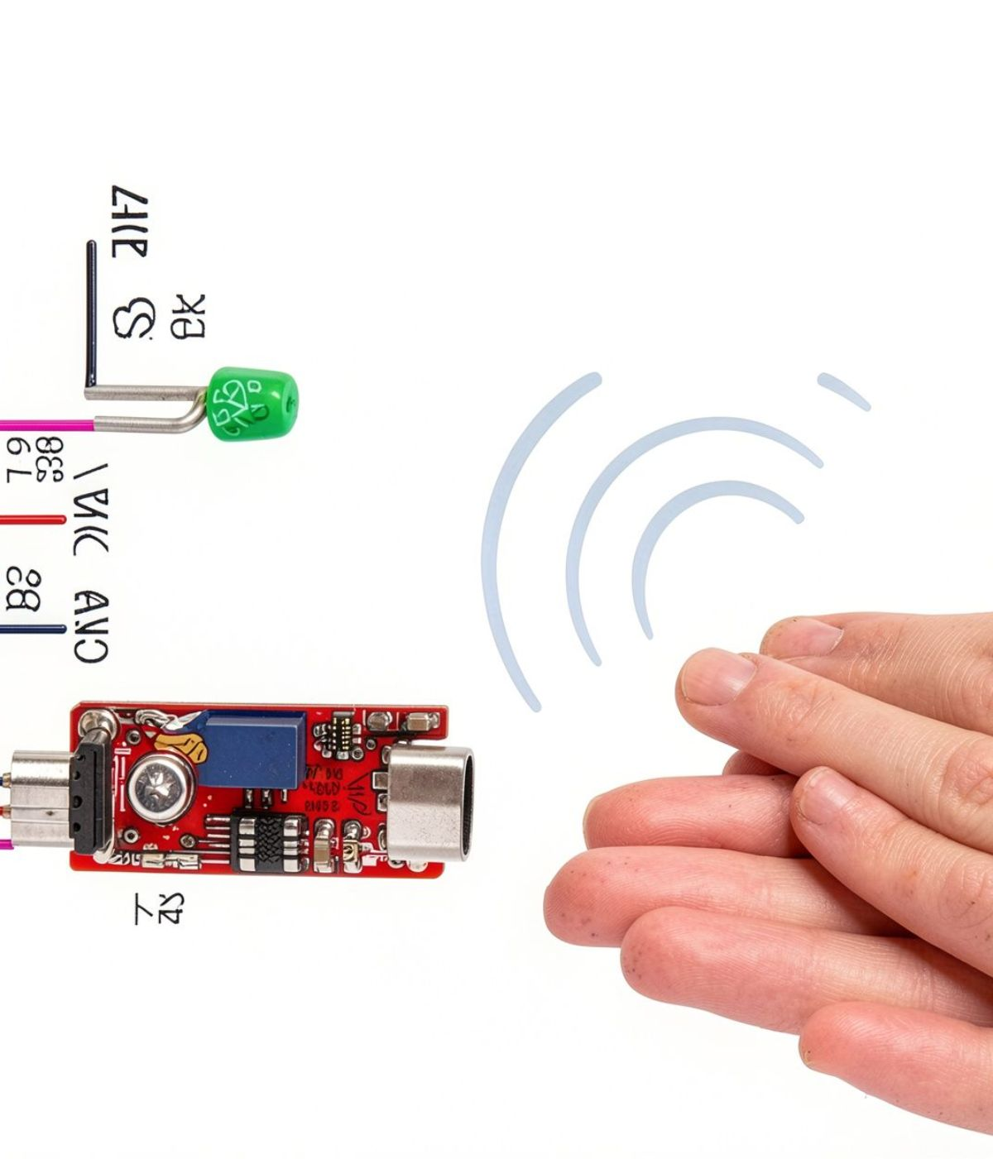
Sound Detection Makes Noise Noticeable
Simple electronic project for detecting sound or loud noise in an environment.
A dedicated sound sensor monitors and senses surrounding acoustic levels.
Buzzer triggers instantly to provide an audible alert when sound crosses the threshold.
Low-cost and accessible, making it practical for learning core electronic circuit principles.

Slide 3
The Project Has Five Clear Objectives
01
02
03
04
05
Detect sound using a sound sensor.
Give an alert when sound is detected.
Understand how a sound sensor works.
Learn basic electronic circuit connections.
Build a simple, low-cost sound detection system.

Slide 4
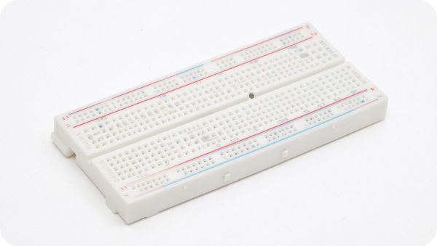


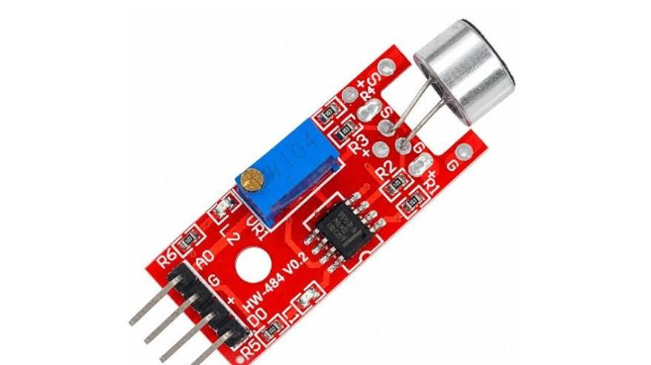
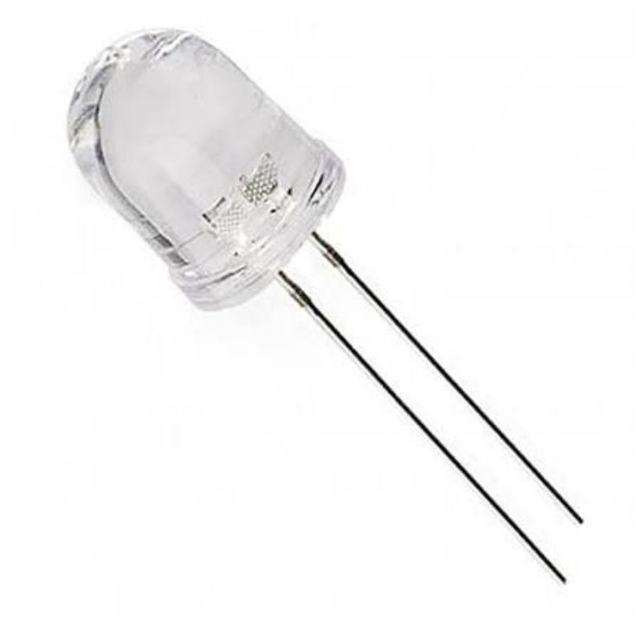
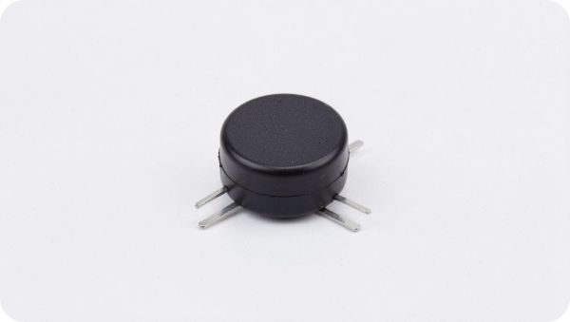
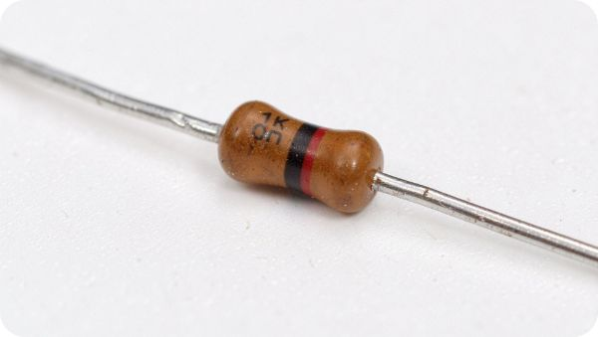
Seven Components Build the Prototype
Breadboard
Jumper wires
9V battery
Sound detection sensor
LED indicator
Buzzer
1K Ohm resistor

Slide 5

Each Component Has a Specific Role
Breadboard
Jumper Wires
Provides tie-points to connect all electronics easily without requiring soldering.
Form secure electrical pathways between the sensor, battery, resistor, and buzzer.
9V Battery
Sound Detection Sensor
Supplies essential steady DC operational voltage to power the complete detection circuit.
Measures incoming sound or noise and converts acoustic vibrations into an electrical trigger.
Buzzer
1K Ohm Resistor
Acts as the alert output by converting output current into an immediate warning tone.
Safeguards the circuit by limiting current flow to protect sensitive components.
LED
Provides a visual indication when sound is detected or the alert is active.

Slide 6
Sound Activates the Alert
1
2
3
4
5
The 9V battery supplies power to the circuit.
The sound detection sensor detects sound.
The sensor sends a signal when sound is detected.
The signal activates the buzzer.
The buzzer produces an alert sound and glow led.
CORE LOGIC SEQUENCE
Sound → Sensor Detects → Signal → Buzzer & Led On

Slide 7
Circuit Diagram: A Simple Signal Path
Conceptual circuit flow
9V Battery
Power source
Sound Detection
Sensor
1K Ohm Resistor
+ LED Indicator
Buzzer
Alert output
Alert Sound
Output
→
→
→
→

Slide 8
The Prototype Is Simple and Practical
Simple and easy to build.
Low-cost project.
Easy to operate.
Quick sound detection.
No soldering required.
Useful for learning basic electronics.

Slide 9
Sound Detection Has Many Uses
Applications
Current Limitations
Security systems and basic intruder alarms
Noise monitoring in quiet rooms and libraries
Automated door alerts and entry notifications
Noise hazard monitoring across industrial zones
School and college mini-project demonstrations
Very faint or low-decibel sounds may remain undetected.
Loud ambient background noise can falsely trigger the alert.
Detection accuracy relies heavily on hardware potentiometer sensitivity.

Slide 10
The Next Version Can Be Smarter
Add Arduino control.
Show readings on an LCD display.
Add ESP32 contol.
Send mobile notifications.
Connect the system to IoT.
Adjust sound sensitivity.
The Sound Detection System demonstrates how sensors, resistors, Led's, buzzers, batteries, and circuit connections work together to create a useful alert system.
Thank you. Any Questions?
Presented by:- Sohel Salim Khatik and Pranav Rajendra Kawar

